Slide 1
Tools for
the assessment of
phenomenon-based learning

Slide 2
Guidelines for using the tools
Do not edit the original files; instead download the tools for editing to your own computer.
The “Modeling of phenomenon-based learning project” at the development services of the Education Division of the City of Helsinki has developed a collection of tools for phenomenon-based learning which can be used to better monitor and assess learning by comprehensive school pupils. The tools include ones aimed at both teachers and learners, and they operate in both the digital (O365 and Google) and physical environments. The tools are freely available for use by everyone, and they can be edited to suit one’s own application.
Notes:
for the suitability of tools for the O365 and Google environments?

Slide 3
Assessment tools for the various phases of phenomenon-based learning
The duration of the process over several weeks
GOALS
PARTICIPATION
ASSESSMENT
Teachers
Survey the subject-specific goals from the curriculum
Select the phenomenon and specify the main goals for the phenomenon
Begin to teach the phenomenon together
Meet the learners at least once during the phenomenon and direct the phenomenon in their respective subjects.
Decide on the phenomenon jointly
Interim assessment of the phenomenon process (pp. 23–25)
Assessment of the process (pp. 23–25)
Subject-specific goals (pp. 4–7)
Goals for transversal competence (pp. 10–19)
Goals of the phenomenon process (pp. 22–25)
Final assessment (p. 8)
GOALS
PARTICIPATION
ASSESSMENT
Learner
Assessment of transversal competence (pp. 16 and 20)
Goals of the phenomenon process (pp. 23–25)
1. Description of the phenomenon
2. Are inspired by the phenomenon
3. Set personal goals
4. Draw up the plan
Share what they have learned with others
Interim assessment and final assessment (p. 8)
Assessment tool for the phenomenon process (pp. 23–25)
Peer review and Help wall
(pp. 28–29)
Assessment of transversal competence (p. 20)
ASSESSMENT TOOLS FOR PHENOMENON-BASED LEARNING

Slide 4
Subject-specific assessment

Slide 5
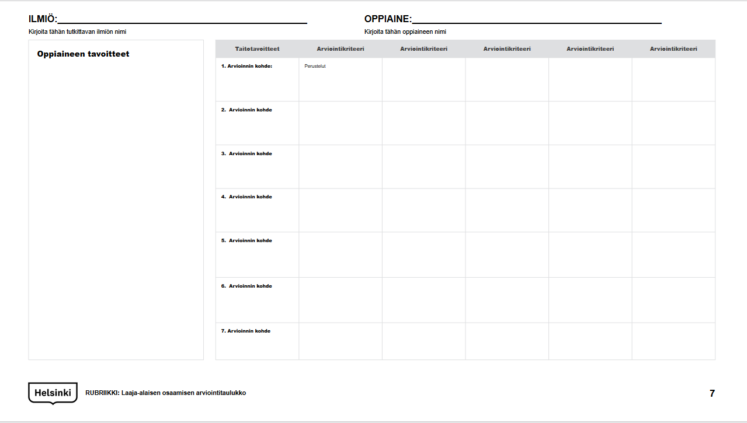
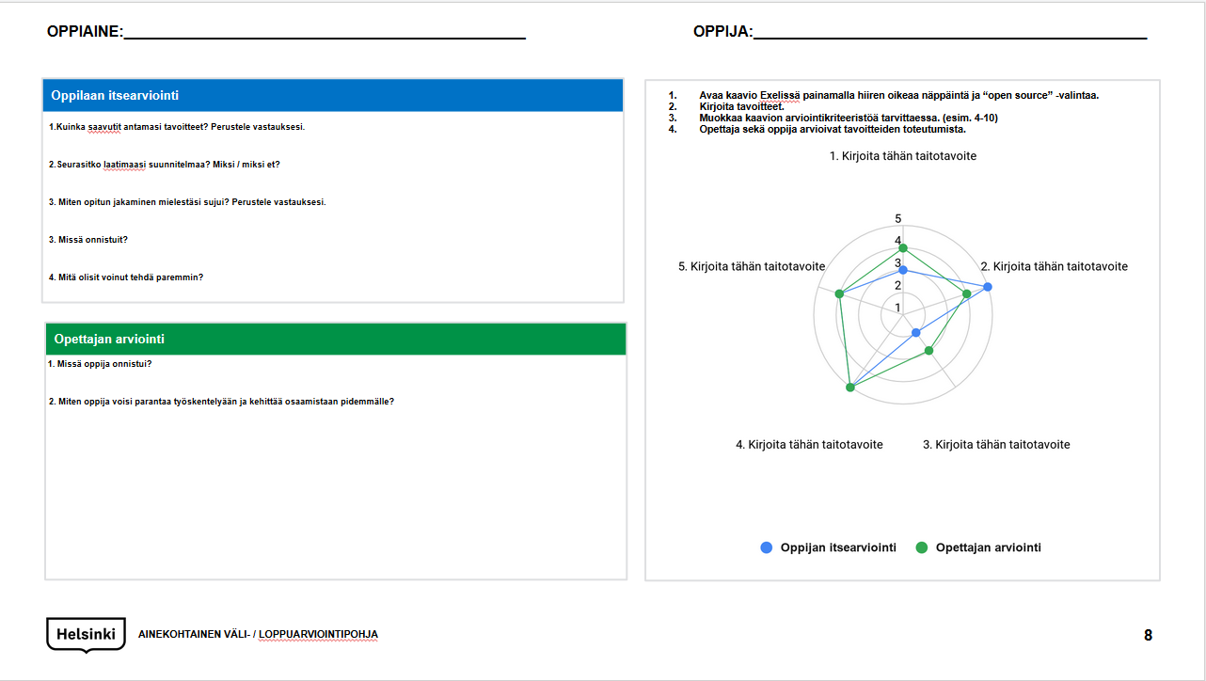
Tools
Assessment table for subject-specific competence (p. 7)
Subject-specific template for interim and final assessment (p. 8)
TOOLS I Subject-specific assessment

Slide 6
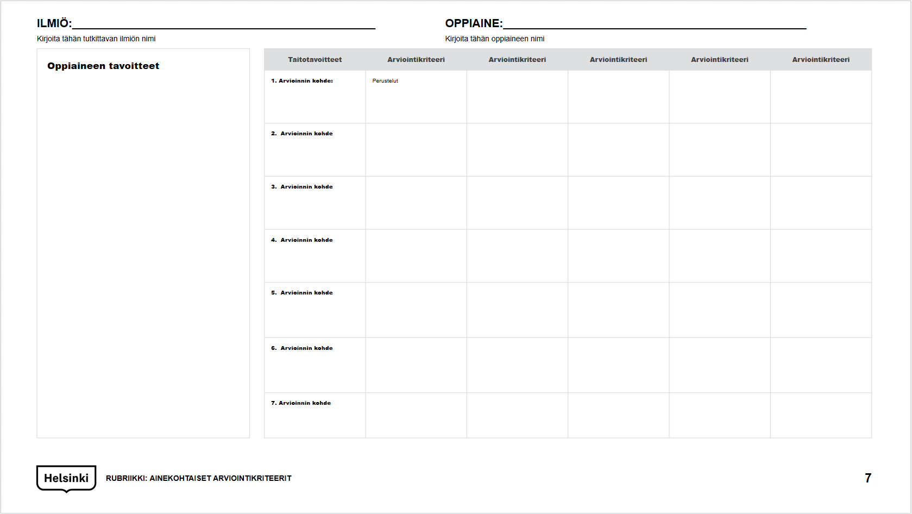
Assessment table for subject-specific competence
Write the objects of assessment in this column.
Write the assessment scale used on this line.
What is a rubric? A rubric, or an assessment table, is an excellent way to make learners see what is being looked for, and how this is displayed in their activity. The task of the assessment table is to concretely describe the kind of competence expected from learners and to make the activity as transparent as possible for both homes and learners.
The assessment criteria used in the rubric can be anything at all, such as:
fail (4), adequate (5), fair (6), satisfactory (7), good (8), very good (9), excellent (10)
you can do this with support, you can do this to a varying extent, you can do this well, you can do this excellently
excellent, good, satisfactory, adequate
The main thing is that the assessment criteria and the descriptions for attaining these are understandable.
These phases must be completed before the tool is used:
Teachers jointly select the phenomenon discussed on the basis of themes that recur in the curriculum.
Teachers identify subject-specific goals associated with the topic, and based on these, specify the shared main goal for the whole phenomenon.
Import the following matters to the rubric:
Teachers add to the rubric the goals of teaching and the objects assessed, which are related to the phenomenon being discussed. (descriptions from the criteria for final assessment https://www.oph.fi/fi/koulutus-ja-tutkinnot/oppiaineiden-paattoarviointi)
Use the rubric as support for the assessment:
The teacher and the learners assess the progress of the learning process and the realization of goals in relation to the assessment criteria imported to the rubric tool.
For each goal, write assessment criteria in which you describe what the realization of the goal means concretely.
Write the goals being learned here. Clearly bring out the goals set for learning whose realization is assessed.
Shade or mark the section that best describes the realization of the goal set. During the process, you can review lessons learned in relation to the assessment criteria and give learners feedback on where you are going, and what could be developed further.
INSTRUCTIONS FOR FILLING OUT THE RUBRIC: Subject-specific assessment criteria

Slide 7
PHENOMENON:________________________________________________
Write the name of the phenomenon studied here
SUBJECT:________________________________________________
Write the name of the subject here
Skill-related goals | Assessment criterion | Assessment criterion | Assessment criterion | Assessment criterion | Assessment criterion
1. Object of the assessment: | Grounds
2. Object of the assessment
3. Object of the assessment
4. Object of the assessment
5. Object of the assessment
6. Object of the assessment
7. Object of the assessment
Goals for the subject
RUBRIC: Assessment table for subject-specific competence

Slide 8
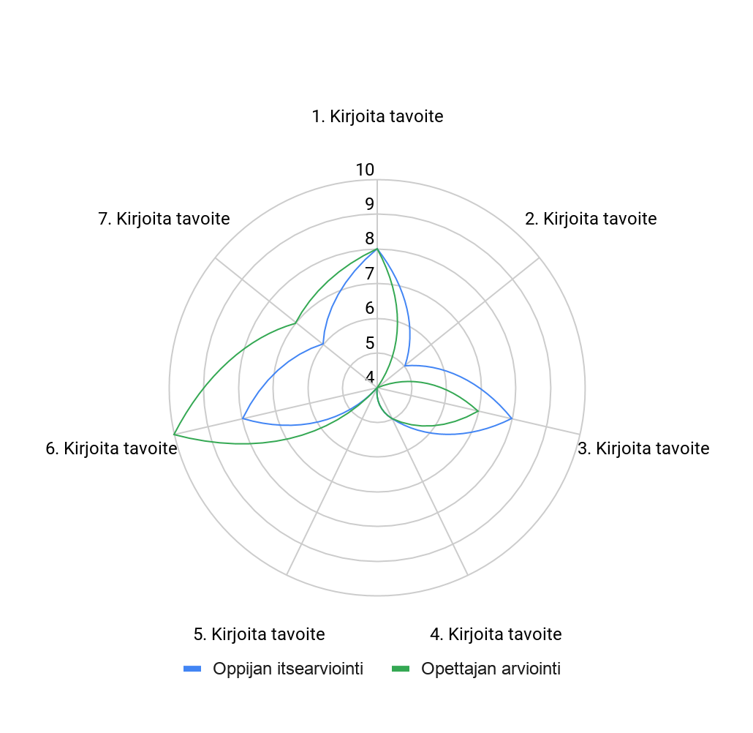
SUBJECT:________________________________________________
LEARNER:_______________________________________________
Self-assessment by the student
Open the diagram in Excel by clicking the right mouse button and on the “open source” selection.
Write the goals.
Edit the diagram’s assessment criteria if necessary (such as 4–10).
The teacher and the learner assess the realization of the goals.
1. How did you achieve the goals you set? State reasons for your answer.
2. Did you follow the plan you drew up? Why/why not?
3. In your opinion, how did you succeed at sharing lessons learned? State reasons for your answer.
3. What did you succeed at?
4. What could you have done better?
Assessment by the teacher
1. What did the learner succeed at?
2. How could the learner improve their work and further develop their competence?
SUBJECT-SPECIFIC TEMPLATE FOR THE INTERIM/FINAL ASSESSMENT

Slide 9
Thank You!

