Slide 1
Tools for
the assessment of
phenomenon-based learning

Slide 2
Guidelines for using the tools
Do not edit the original files; instead download the tools for editing to your own computer.
The “Modeling of phenomenon-based learning project” at the development services of the Education Division of the City of Helsinki has developed a collection of tools for phenomenon-based learning which can be used to better monitor and assess learning by comprehensive school pupils. The tools include ones aimed at both teachers and learners, and they operate in both the digital (O365 and Google) and physical environments. The tools are freely available for use by everyone, and they can be edited to suit one’s own application.
Notes:
for the suitability of tools for the O365 and Google environments?

Slide 3
Assessment tools for the various phases of phenomenon-based learning
The duration of the process over several weeks
GOALS
PARTICIPATION
ASSESSMENT
Teachers
Survey the subject-specific goals from the curriculum
Select the phenomenon and specify the main goals for the phenomenon
Begin to teach the phenomenon together
Meet the learners at least once during the phenomenon and direct the phenomenon in their respective subjects.
Decide on the phenomenon jointly
Interim assessment of the phenomenon process (pp. 23–25)
Assessment of the process (pp. 23–25)
Subject-specific goals (pp. 4–7)
Goals for transversal competence (pp. 10–19)
Goals of the phenomenon process (pp. 22–25)
Final assessment (p. 8)
GOALS
PARTICIPATION
ASSESSMENT
Learner
Assessment of transversal competence (pp. 16 and 20)
Goals of the phenomenon process (pp. 23–25)
1. Description of the phenomenon
2. Are inspired by the phenomenon
3. Set personal goals
4. Draw up the plan
Share what they have learned with others
Interim assessment and final assessment (p. 8)
Assessment tool for the phenomenon process (pp. 23–25)
Peer review and Help wall
(pp. 28–29)
Assessment of transversal competence (p. 20)
ASSESSMENT TOOLS FOR PHENOMENON-BASED LEARNING

Slide 4
Assessment of the Phenomenon-based Learning Process

Slide 5
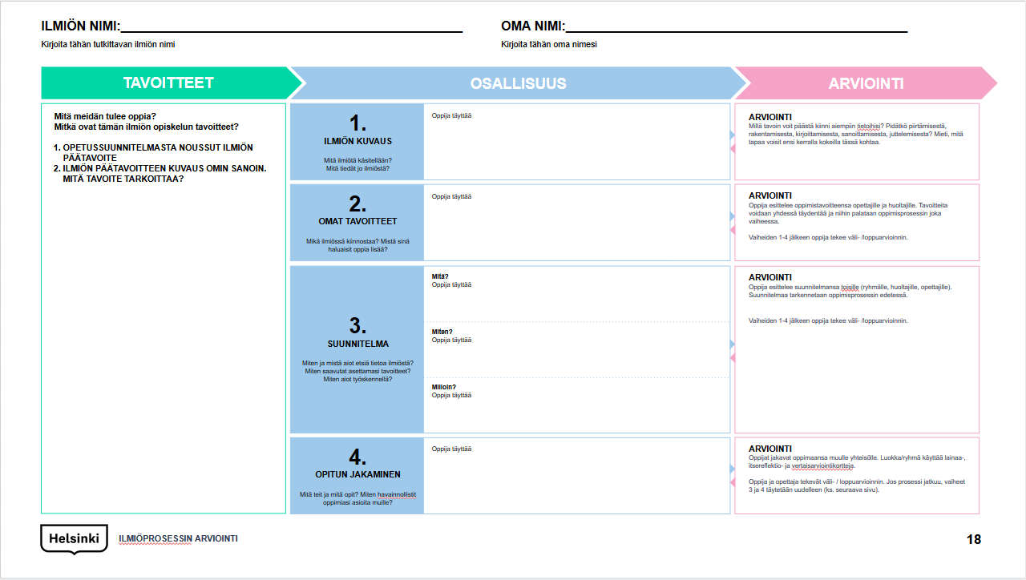
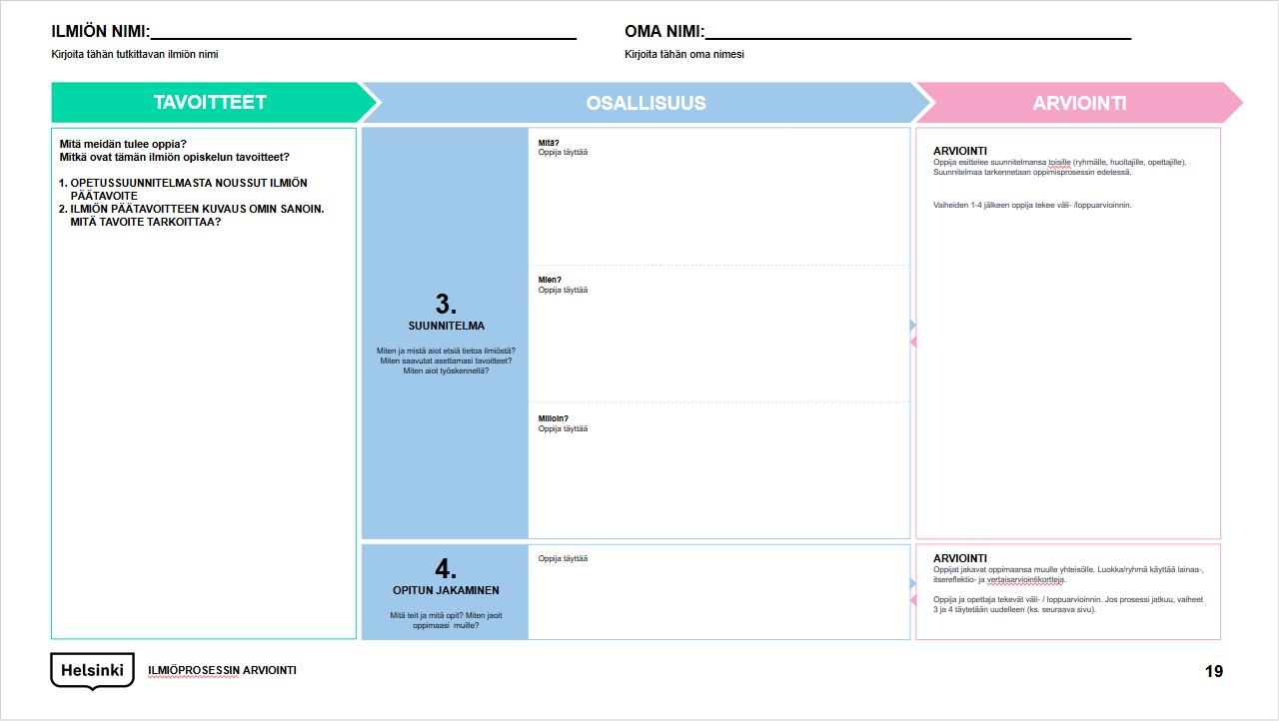
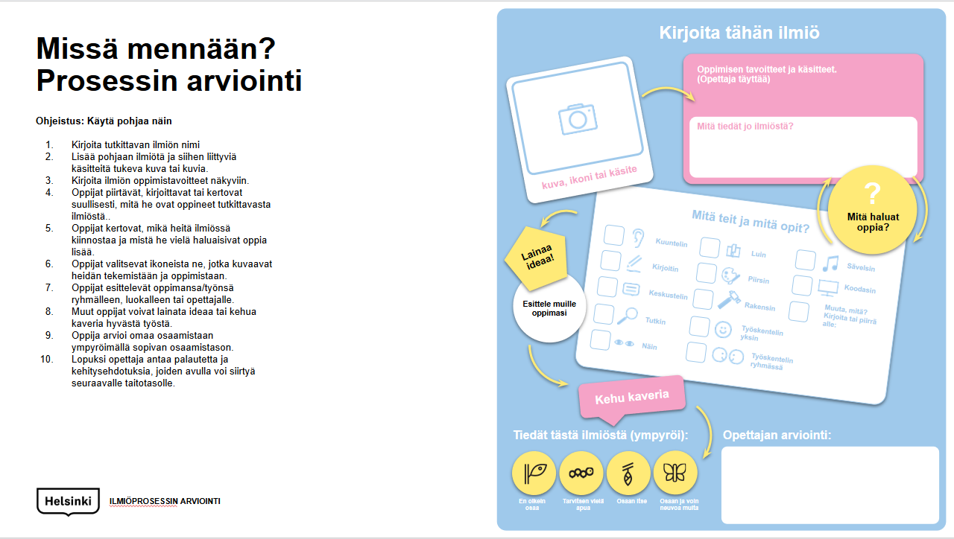
Tools
Assessment of the phenomenon process A (p. 23)
The purpose of the assessment tool of the phenomenon process is to walk alongside the learner, from the beginning of the process until its conclusion. Learners do not fill out this assessment template in one go; instead, they evaluate their work and thoughts, and what they have learned from one phase to the next. The phenomenon process takes several weeks, so learners should have a tool that reminds them of the goals set and helps them adjust the meaningful progress of the process in their direction.
Assessment of the phenomenon process B (p. 24)
Items 3 and 4 of the tool may be repeated several times when the phenomenon is studied, because the larger whole consists of several sections, and it is important to set specific goals for all of them, draw up one’s own work plans and assess the realization of goals and plans along the way.
Visual assessment template of the phenomenon process (p. 25)
A visual printout template for the assessment of the phenomenon process.

Slide 6
NAME OF THE PHENOMENON:________________________________________
Write the name of the phenomenon studied here
YOUR OWN NAME:________________________________________________
Write your own name here
GOALS
PARTICIPATION
ASSESSMENT
1.
DESCRIPTION OF THE PHENOMENON
What phenomenon is being discussed?
What do you already know about the phenomenon?
A
What should we learn?
(The main goal of the phenomenon that has come from the curriculum)
What are the goals for studying this phenomenon?
(A description of the main goal for the phenomenon in your own words. What does the goal mean?)
PARTICIPATION
ASSESSMENT
How can you access your previous information? Do you like to draw, build, write, put things into words, talk to people? Think of a way you could experiment with this next time.
2.
YOUR OWN GOALS
What is of interest to you in the phenomenon? What would you
like to learn more about?
ASSESSMENT
The learner presents their learning goals to the teachers and custodians. The goals can be supplemented together, and you will return to them in every phase of the learning process.
The learner prepares an interim/final assessment after phases 1–4.
3.
PLAN
How and where do you intend to search for information about the phenomenon?
How will you achieve the goals you have set?
How do you intend to work?
What?
ASSESSMENT
The learner presents their plan to others (group, custodians, teachers). The plan is clarified as the learning process progresses.
The learner prepares an interim/final assessment after phases 1–4.
How?
When?
4.
SHARING LESSONS LEARNED
What did you do and what did you learn? How did you illustrate what you have learned to others?
ASSESSMENT
The learners share what they have learned with the rest of the community. The class/group uses borrowing, self-reflection and peer review cards.
The learner and the teacher prepare an interim/final assessment. If the process continues, phases 3 and 4 are filled out again (see the next page).
ASSESSMENT OF THE PHENOMENON PROCESS

Slide 7
NAME OF THE PHENOMENON:________________________________________
Write the name of the phenomenon studied here
YOUR OWN NAME:________________________________________________
Write your own name here
GOALS
PARTICIPATION
ASSESSMENT
3.
PLAN
How and where do you intend to search for information about the phenomenon?
How will you achieve the goals you have set?
How do you intend to work?
What should we learn?
(The main goal of the phenomenon that has come from the curriculum)
What are the goals for studying this phenomenon?
(A description of the main goal for the phenomenon in your own words. What does the goal mean?)
PARTICIPATION
What?
ASSESSMENT
The learner presents their plan to others (group, custodians, teachers). The plan is clarified as the learning process progresses.
The learner prepares an interim/final assessment after phases 1–4.
How?
When?
4.
SHARING LESSONS LEARNED
What did you do and what did you learn? How did you share what you have learned with others?
ASSESSMENT
The learners share what they have learned with the rest of the community. The class/group uses borrowing, self-reflection and peer review cards.
The learner and the teacher prepare an interim/final assessment. If the process continues, phases 3 and 4 are filled out again.
ASSESSMENT OF THE PHENOMENON PROCESS

Slide 8
Where are you going?
Assessment of the process
?
Write the phenomenon here
Goals and concepts of learning.
What do you already know about the phenomenon?
Instructions: Use the template like this
Write the name of the studied phenomenon
Add the phenomenon and image(s) supporting concepts associated with it to the template.
Write the learning goals concerning the phenomenon so they are visible.
Learners draw, write or verbally describe what they have learned of the phenomenon being studied.
Learners describe what in the phenomenon interests them and what they would like to learn more about.
Learners choose the icons that describe their actions and learning.
Learners present lessons learned/their work to their group, class or teacher.
Other learners can borrow an idea or compliment a friend on good work.
Each learner assesses their own competence by circling the appropriate competence level.
Finally, the teacher provides feedback and development proposals that can be used to proceed to the next skill level.
image, icon or concept
What do you want to learn?
What did you do and what did you learn?
Borrow an idea!
I listened
I read
I composed
I wrote
I drew
I coded
Present what you have learned to the others
I discussed
I built
Something else – what?
Write or draw below:
I explored
I worked alone
Like this
I worked in a group
Compliment a friend
You know about this phenomenon (circle):
Assessment by the teacher:
ASSESSMENT OF THE PHENOMENON PROCESS
I can’t quite do it
I still need help
I can do it myself
I can do it, and I can advise others

Slide 9
Thank You!

